Slide 1
Cluster Sizing – Best Practices

Slide 2
Memory
Provisioning nodes that have too much memory can be detrimental as GC becomes more expensive over large heaps.
To determine exactly how much memory is needed by a specific application, a percentage of the entire dataset can be loaded and cached in memory; go to the storage tab and review how large the dataset is at rest in memory and extrapolate it out to determine its total size if it were to be completely in memory.

Slide 3
Network
Once an application's dataset fits in memory, the application typically becomes network-bound, especially for distributed reduce processing such as groupBys, joins and transformations requiring a shuffle.
The simplest way to understand the impact of large shuffles on your application's performance is to use the Spark UI (available on http://<driver-node>:4040 by default) to look at the volume of data shuffled and correlate it to how long it takes a stage to complete its processing.

Slide 4
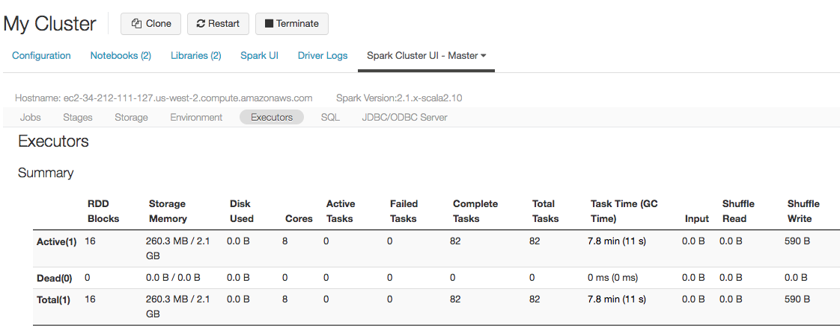
CPU
As there is minimal sharing of resources between threads, Spark scales well with tens of CPU cores per machine. Recommendations for per-executor provisioning advise that a minimum of 8 Spark cores is a good starting point. Depending on how CPU intensive the workload of an application might be, more cores can be provisioned with the upper limit per executor being 16 cores.
Again, these are guidelines, depending on the workload more cores might be required as typically once an application's data is in memory, that application becomes CPU or network bound. As before, the best way of reviewing available resources is to look at the Spark UI. This time, rather than looking at the main (driver) UI, we're the Spark Master UI, which is typically available on http://<spark-master-node>:8080 (for vanilla Spark distributions) and in DataBricks under Clusters > Spark UI > Spark Cluster UI - Master.

Slide 5
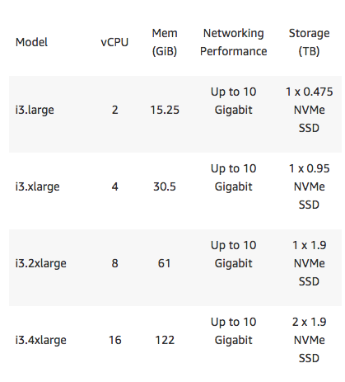
Disk
The types and number of disks on a single machine are a huge factor when dealing with job throughput. All shuffle partitions write to local disks and are then read from the node[s] selected to complete the shuffle composite; an SSD is going to read/write much faster than a spinning disk thus select nodes with SSDs as local storage and provision Auto Scaling Local Storage to acquire more as necessary.
Right: Notice how as the nodes get larger so do the default local SSDs sizes and counts allowing for larger shuffles before any additional SSDs are necessary. This allows for greatly improved performance.

Slide 6
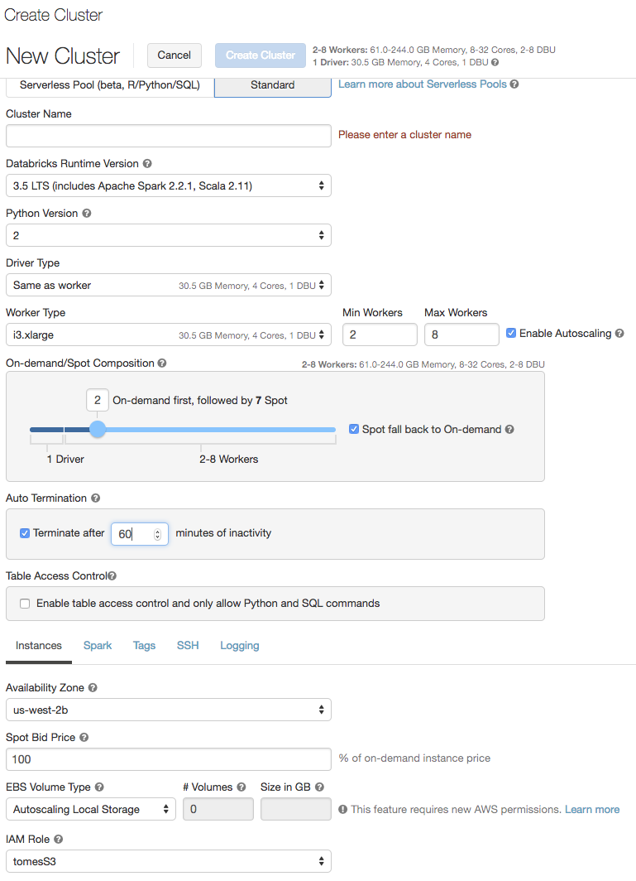
A Cluster for the Job
When working with transient clusters in the cloud it’s important to build the correct cluster for the job/data you’re working on. Since clusters are transient and the data is not, it’s easy to have different clusters for different workloads. In development a good way to handle this is to use a node type with SSDs and auto-scale your node count and storage to a maximum somewhere within reason.
This will allow for SSDs to be provisioned as the job calls for it (large shuffles or persisted data to disk). Once the disks are no longer needed, they will be removed even if the cluster is still in use. The same goes for the additional nodes that may be needed as the job requires larger task counts.

Slide 7
A Cluster for the Job
5 Key Components When Creating A Cluster
Enable Autoscaling – Select a reasonable min and max for the type of work loads you’ll be sending to the cluster.
Auto Termination – Always enable this – this ensures that if you forget to terminate your cluster when you’re done it will shut itself down after being idle for n minutes. The clusters only take a few moments to spin up so it’s not a big inconvenience but it can save a lot of L1 money.

Slide 8
A Cluster for the Job
5 Key Components When Creating A Cluster
Spot Count – Require the minimum (2) workers be on-demand and then allow the rest to be Spot, this means that L1 will only pay the current spot market price for the node (usually significantly less than market price).
Spot Bid Price – Set this to 100%. This will enable a price reduction even if the spot market is only 1% below market
EBS Volume Type – Set to Autoscaling Local Storage; allows for SSDs to be provisioned as needed to accommodate persisted datasets and shuffles.

Slide 9
Appropriate Data Sets
Just as you right-size the cluster for the job/data it’s important that you right-size the data for the development stage you’re in.
For example, when first starting a development cycle, identify the large datasets with which you intend to work; find a way to shrink these data sets down to a very small subset, perhaps 1-10% of full size; exactly correct outputs don’t matter at this stage of development, so don’t try to accomplish output validation at this stage. If there are multiple large datasets, pair them all down but make sure that you select the same base key set (context) such that all the joins will be valid; keys on the left should be present on the right as well. It may take up to an hour or two to get this data paired down and stored so that it can be used throughout the development lifecycle but it’s extremely worthwhile; then benefits include:
Iterative, real-time development. Cache the data sets and all queries return instantly.
Large clusters are not necessary
If/when mistakes are made, the output is small thus the cleanup time is short
Right-sizing the full-size cluster can be done scientifically rather than guessing. For example, if your data subset is 10% of the full data set, you can surmise that the full dataset will be 10X the size thus the cluster necessary to handle that is N nodes of type X. This goes for the entire pipeline, read partitions, shuffle partitions, etc.

Slide 10
Selecting Node Type
As you can see below there are an ever growing number of node options from which to select. The following slides will attempt to help you determine the best types of nodes and how many to use to optimize for your workload.
https://aws.amazon.com/ec2/instance-types/
Node Type | Memory | CPU | Storage | Use Case
r4 | Average | Average | Poor | ETL – NO SLA
r3 | Average | Average | Excellent | ETL – NO SLA
c4 | Poor | Excellent | Poor | ML
c3 | Poor | Excellent | Excellent | ML
i3 | Good | Average | Excellent | ETL
i2 | Good | Average | Excellent | ETL
p2 | Average | Excellent | Poor | DL
m4 | Poor | Poor | Poor | Housekeeping

Slide 11
Selecting Driver Node Size
Drivers often times don’t do much in the way of resource intensive tasks like the workers since they typically act solely as a coordinator for the worker nodes. This is true except, but not limited to, cases where:
Large datasets are being returned to the driver
The driver is doing heavy lifting for complicated graphics or visualizations
The job is broadcasting large variables – These variables have to be collected to the driver first and then sent to all the workers thus sufficient memory size on the driver is crucial
Parallel/Threading tasks are being executed on the driver through parallelized arrays or threading
The four points above are only examples where larger drivers are helpful. The key point here is that generally speaking, the drivers don’t need to be very large but just keep in mind the work that is to be performed by the driver and size it accordingly.

Slide 12
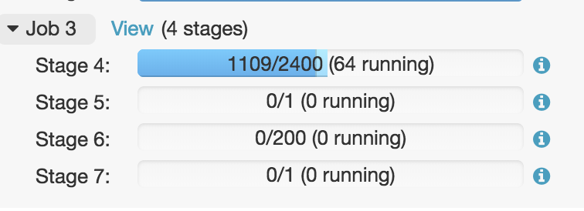
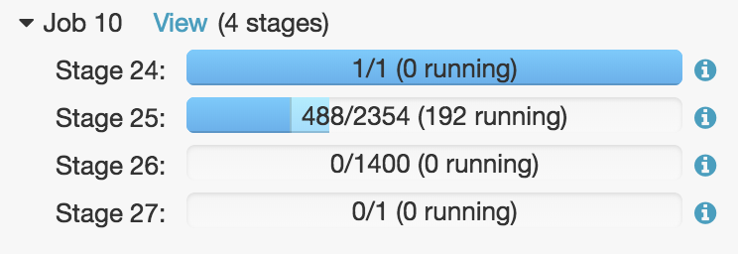
Selecting Worker Node Size
Assuming both jobs on the right have the same number of nodes, it’s clear that the bottom one is going to finish faster. Notice the increased concurrent running tasks. Since we have more tasks that can run simultaneously it’s important to boost shuffle partitions to take advantage of the extra cores and memory. There’s no point in having 1500 cores and only 200 shuffle partitions.
Read Partitions
Shuffle Partitions
The job on the bottom will run even faster with more than 192 cores. Note: The job on the top will not benefit much from any more than 200 cores, after 200 cores, there will be significant waste in the shuffle stage unless # of shuffle partitions is increased by modifying spark.sql.shuffle.partitions parameter.
At 192, the cluster has already scaled up to its maximum size. At this point, the developer must ask him/herself if he/she can justify the cost of more nodes; if so, stop your cluster and increase the upper limit for auto scaling or change your node type to be larger, whichever makes more sense. If not, either pair down the data set or just wait for the job to finish.

Slide 13
Selecting Worker Node Size
General Reference
Ensure that no executor task is consuming more than 2GB of memory, ideally <1GB
Node CPU Count X # of Nodes = Concurrent Running Capacity
Larger nodes -> Increased CPU, Storage, Memory & Faster Networks
Larger nodes -> Great for Large Jobs with Large Shuffles
Large Shuffles -> Increase shuffle partitions to utilize all CPUs and ensure executor memory stability (<2GB/executor)

Slide 14
How Many Nodes
Generally, enable auto-scaling 2 -> n nodes
Allow more partitions to be solved simultaneously by increasing node count
No point having more available CPUs than partitions to process
Watch for data skew (<10% of partitions requiring >80% of job time) – more nodes will not help unless a repartition is added to the DAG

Slide 15
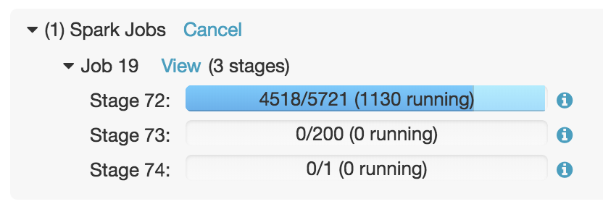

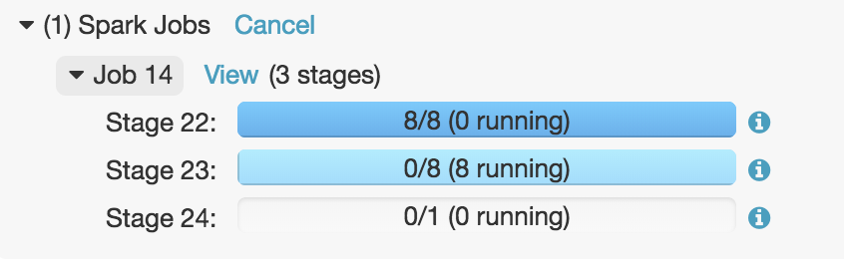
How Many Nodes
Increase spark.sql.shuffle.partitions
With >1100 cores and only 200 shuffle partitions, your job may fail; either way, the job is wasting nearly 1000 cores during the shuffle stage (73)
Incorrect Shuffle Partitions
Incorrectly Sized
4 cores
1400 cores
As 4 slots on dataset requiring ~1400 partitions is not appropriate neither is ~1400 cores on a dataset requiring 4 partitions
Incorrectly Sized

Slide 16
Data Skew
What is: Data skew is an important factor when dealing with cluster sizing and utilization. Highly skewed data results in a large portion of your data being trapped inside of a few tasks ultimately causing a high percentage of your data to be processed by a small percentage of available cores which can lead to memory overload (i.e. job failure) and extremely long running jobs.
Identifying: Data skew can most quickly be identified when most tasks finish very quickly in a single stage but some continue running for much longer. This can further be confirmed by going to the Spark UI for the stage and reviewing the quartile distribution of input size/records and/or shuffle size/records. If there is a much larger number in the 75th percentile than the 25th you know there’s heavy skew in your data
Resolution:
Reshape your input data in an upstream stage
Repartition the skewed data immediately after it’s read into the job. This can either be done with the standard hash partitioner or a custom partitioner can be created.
If caused by a join and the small DF is small enough, broadcast the smaller DF to help

Slide 17
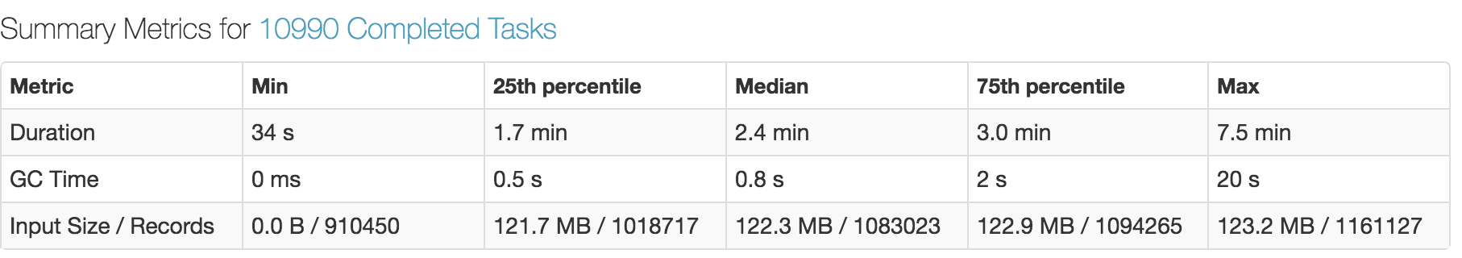
Data Skew - Identification
Below is a screen shot of some well distributed data. Highly skewed data would see a difference between the 25th and 75th percentiles of ~> 20%.
( 122.9 – 121.7 ) / 122.9 = <1% difference
Note that skew on smaller datasets is less of an issue, the problem grows exponentially with data size

